Slide 1
Database Management
Systems
Section-5 Group-03

Slide 2
CSE303, Section-5
Group-03
Group Members:
KM Shaide Afride - 2021211
Farhan Zaman Hamim - 2022157
Saniul Islam Sani - 2022605
Zahidul Islam - 2022504
Md. Ashaduzzaman Nur- 1910397
Md. Omar Bin Sarwar-2021237

Slide 3
OBJECTIVE OF THE PROJECT - Assists educational institutions in tracking performance of students, teachers, departments, schools, and programs - Keeps data on assessments, course outlines, and grades in a database for analysis - Analyzes student learning objectives to identify areas for improvement and track performance - Provides reports to higher authorities to improve educational quality and make informed decisions

Slide 4
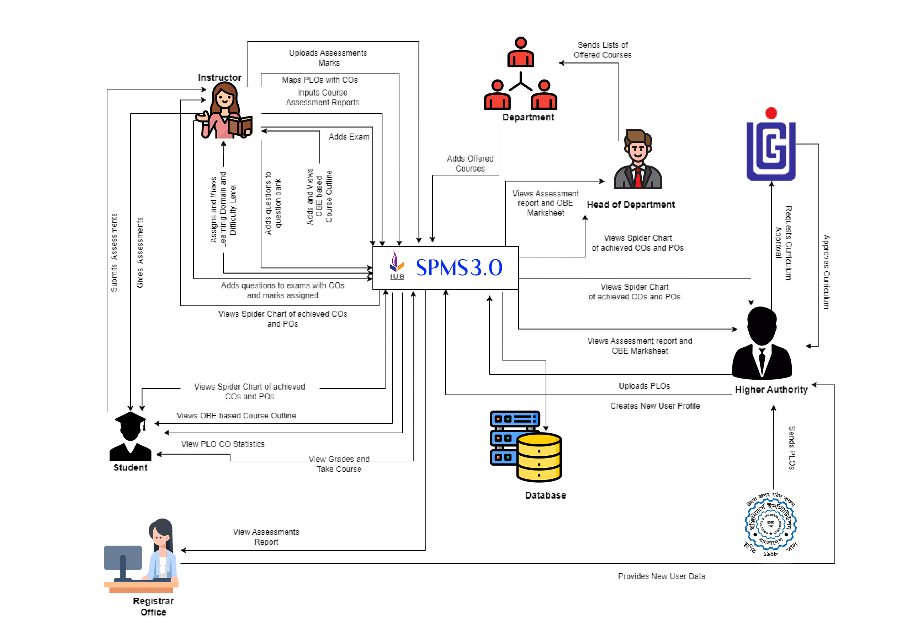
Rich Picture (As-Is)

Slide 5
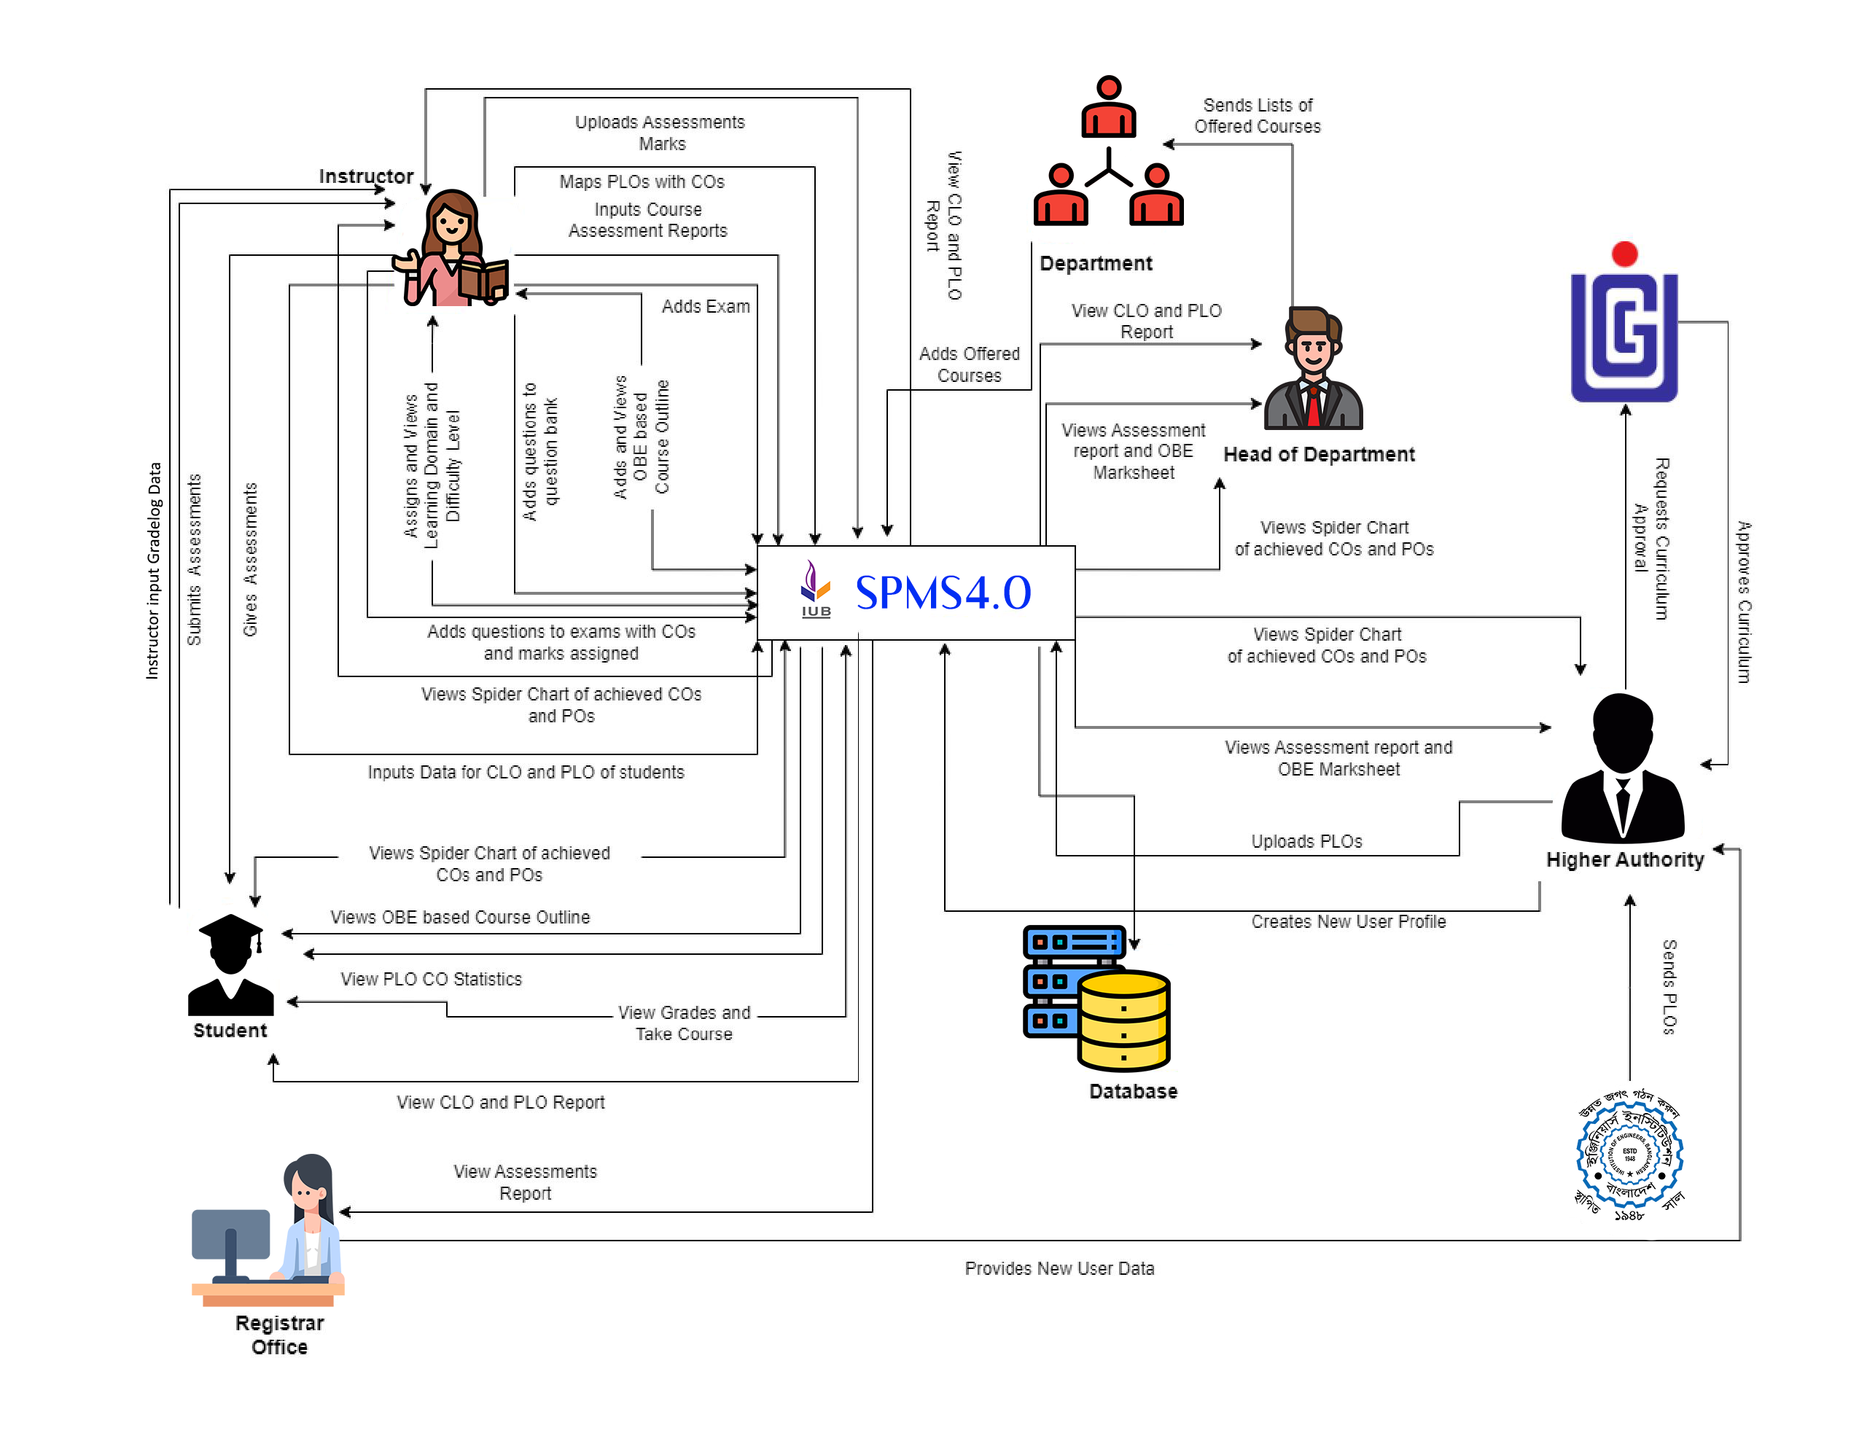
Rich Picture (To-Be)

Slide 6
Six Elements Analysis (As-Is)
Collection of manual :
BAETE provides manual.
Admin provides the manual to higher authorities for initial mapping
Mapping of COs and PLOs:
Higher Authorities : Matchs COs with PLOs, maps the course and provides the map
Faculties : Receives the map and updates COs and PLOs

Slide 7
Six Elements Analysis (As-Is)
Faculty creates course outline and assessment plan
Gathers data from web
Determines course contents according to CO and PLOs
Fulfill COs and PLOs
Creates questions according to Bloom Taxonomy
Provides policies
Compiles all
Generate pdf format course outline

Slide 8
Six Elements Analysis (As-Is)
Faculty makes question paper for assessment
Makes question paper
Researches to make appropriate question paper
Sets mark according to COs
Takes assessment
Faculty takes attendance
Takes attendance manually

Slide 9
Six Elements Analysis (To-Be)
Faculty checks scripts and grades them
Upload marks
Grades them
Grade sheet
Input marks in manual form
Upload csv file
Store database
Submits them

Slide 10
Six Elements Analysis (To-Be)
Course Outcome Percentage Calculation
New feature implemented in web application
Calculates course outcome percentage based on obtained grades for each course
Displayed to students and faculty members in the web application.

Slide 11
Problem Analysis
Submission in OBE of course outline
Problem : Higher authorities provide the course guidelines and then faculty can update
Solution : Elimination of higher authorities and giving direct access to faculty members
Grade Sheet Generator
Problem : Input is manually taken so typing error is possible , no automated reports to generate specific feedbacks
Solution : A system where it can automatically calculate average for exams

Slide 12
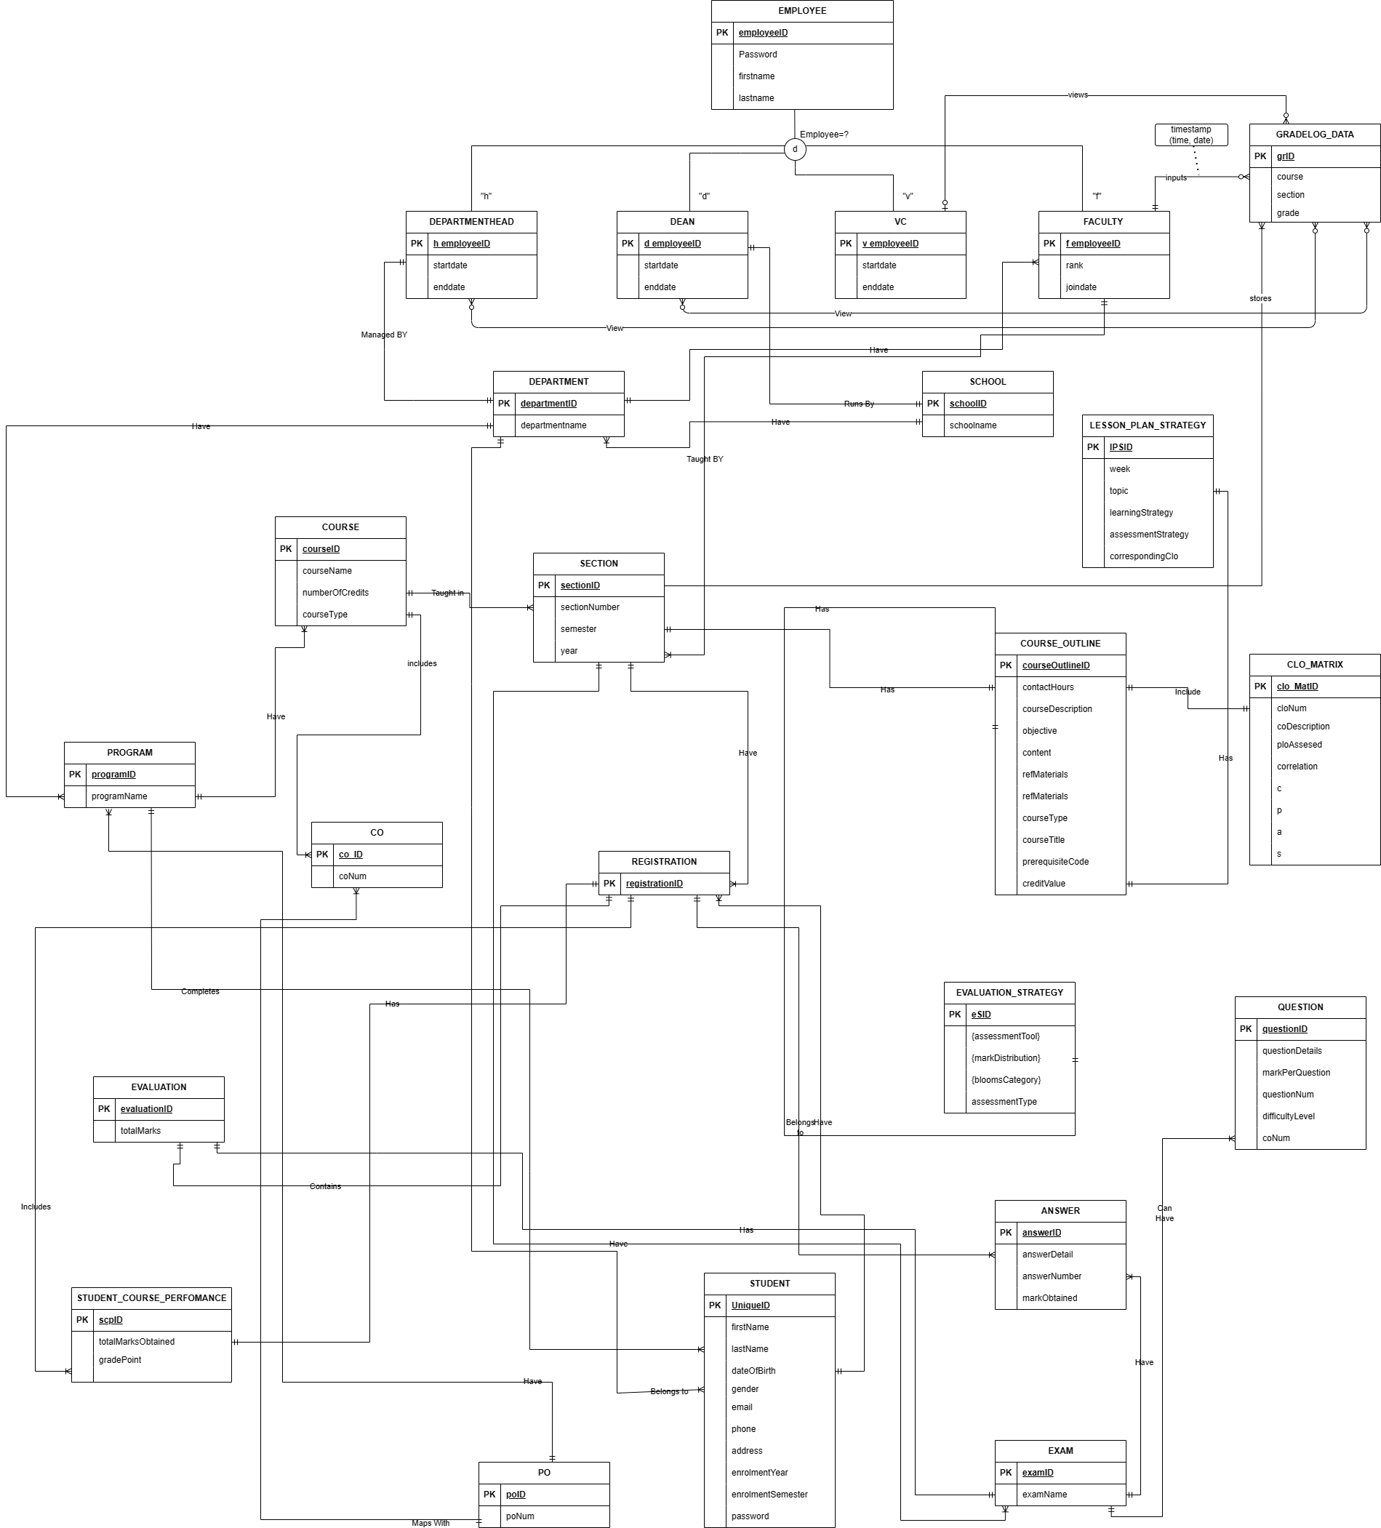
Design : Entity Relationship Diagram

Slide 13
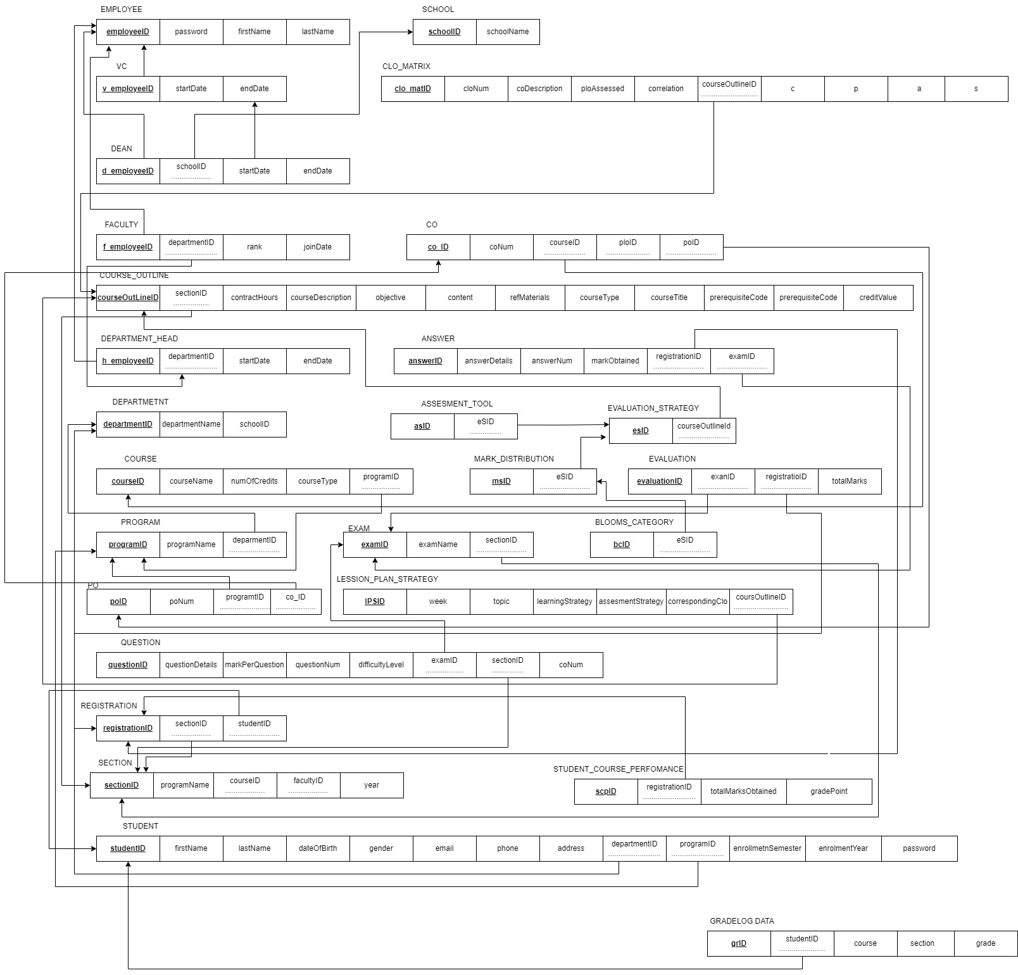
Design : Relational Schema

Slide 14
Future Scope
-Future plan for SPMS 4.0 includes integration with other educational technology platforms
- Goal is to improve accuracy and effectiveness of outcome-based education frameworks
- Enhance user experience while complying with ethical standards and regulations.

Slide 15
Thank You

